Slide 1

FASTFOOD – PIZZA SALES ORDER ANALYSIS

Slide 2
STEPS EXECUTED
Download data in Excel/ CSV format
Create databases & tables in MYSQL workbench
Insert data into tables
Create DFD / schema diagrams
Run DRQ queries
Export data in excel format
Analyze exported data & draw conclusions
Present the observations

Slide 3
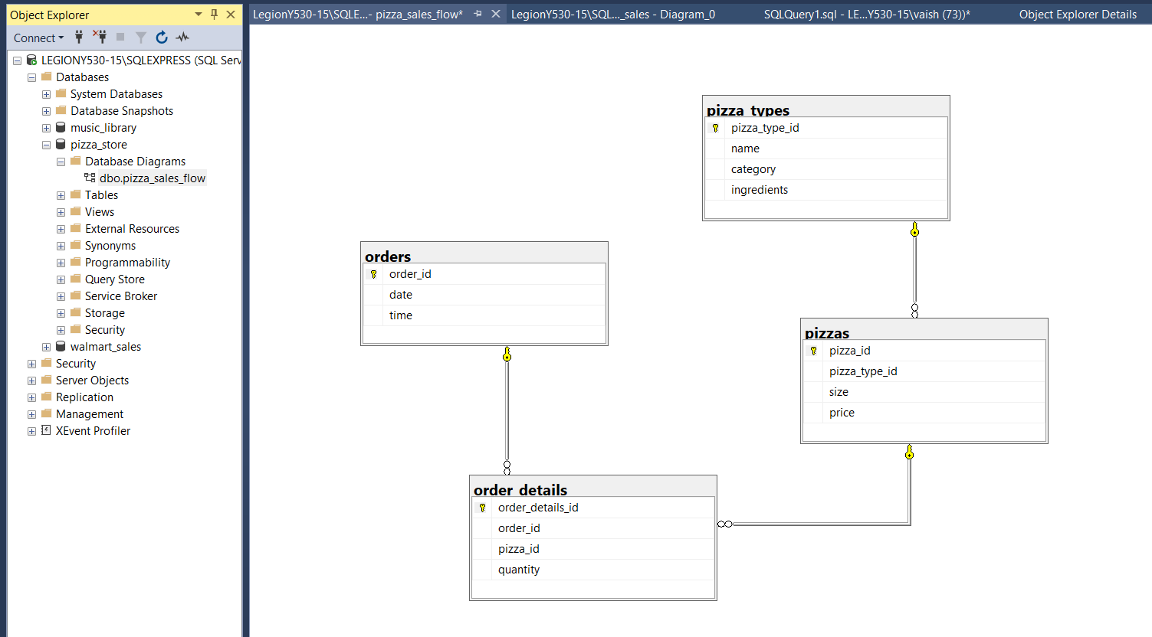
DATA FLOW / SCHEMA DIAGRAM
DATA SOURCE -

Slide 4
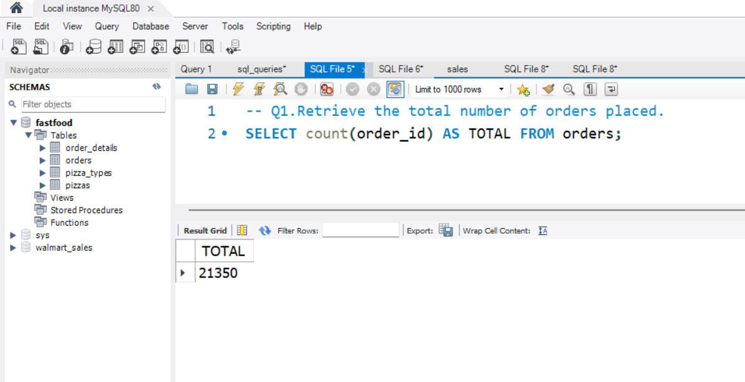
SQL QUERY TO FIND TOTAL ORDERS PLACED
LEVEL - BASIC

Slide 5
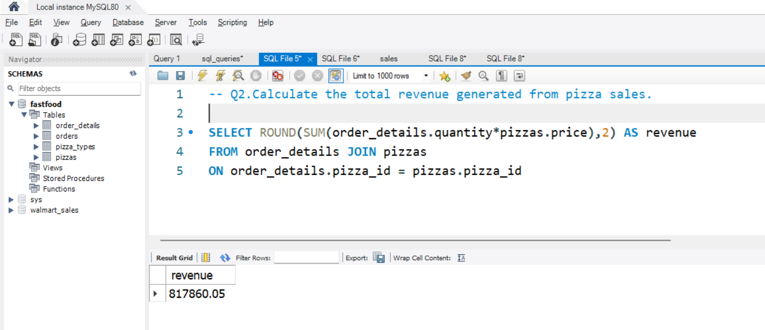
SQL QUERY TO FIND TOTAL REVENUE FROM SALES
LEVEL - BASIC

Slide 6
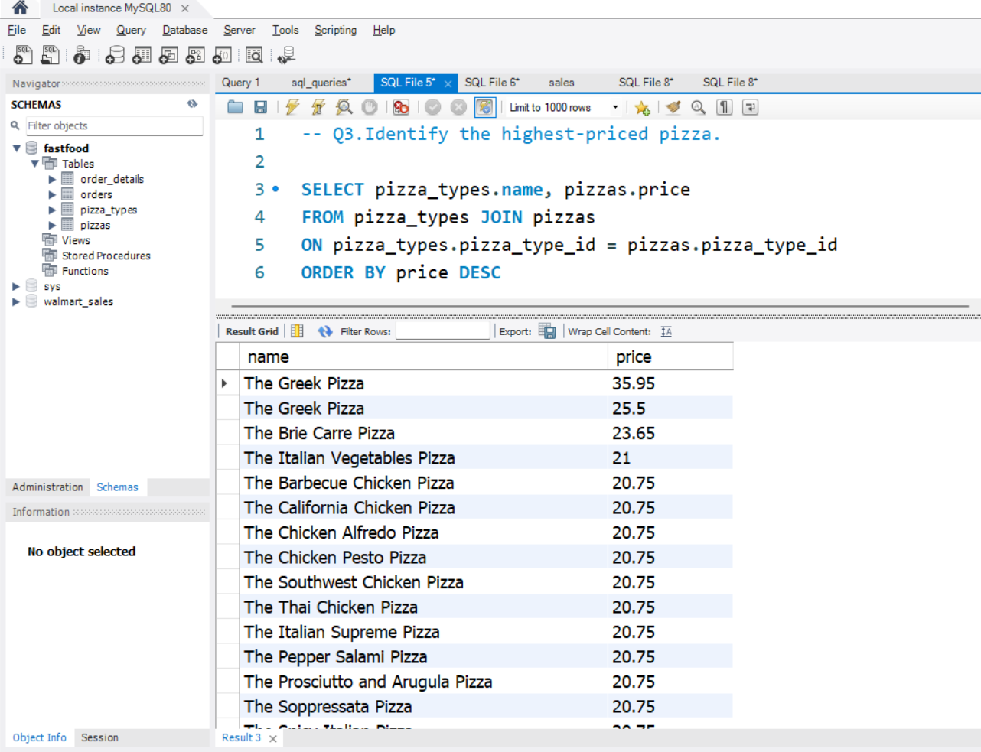
SQL QUERY TO FIND THE HIGHEST PRICED PIZZA
LEVEL - BASIC

Slide 7
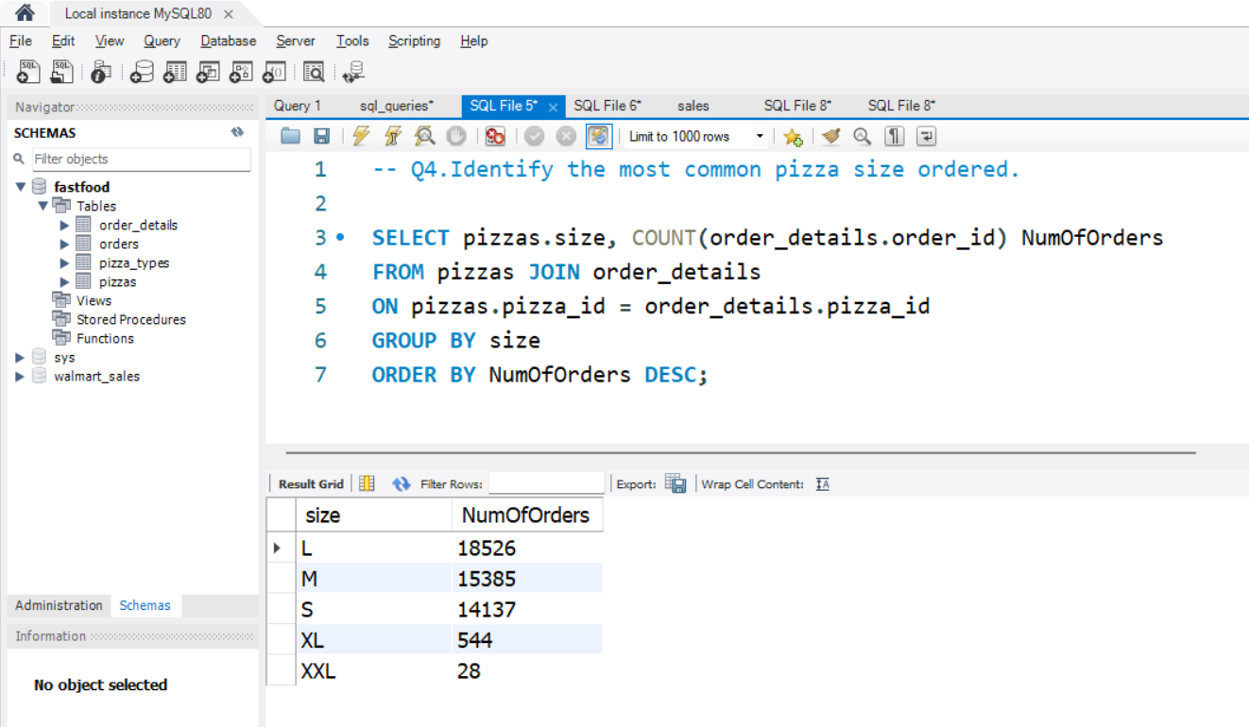
SQL QUERY TO FIND THE FREQUENTLY ORDERED PIZZA SIZE
LEVEL - BASIC

Slide 8
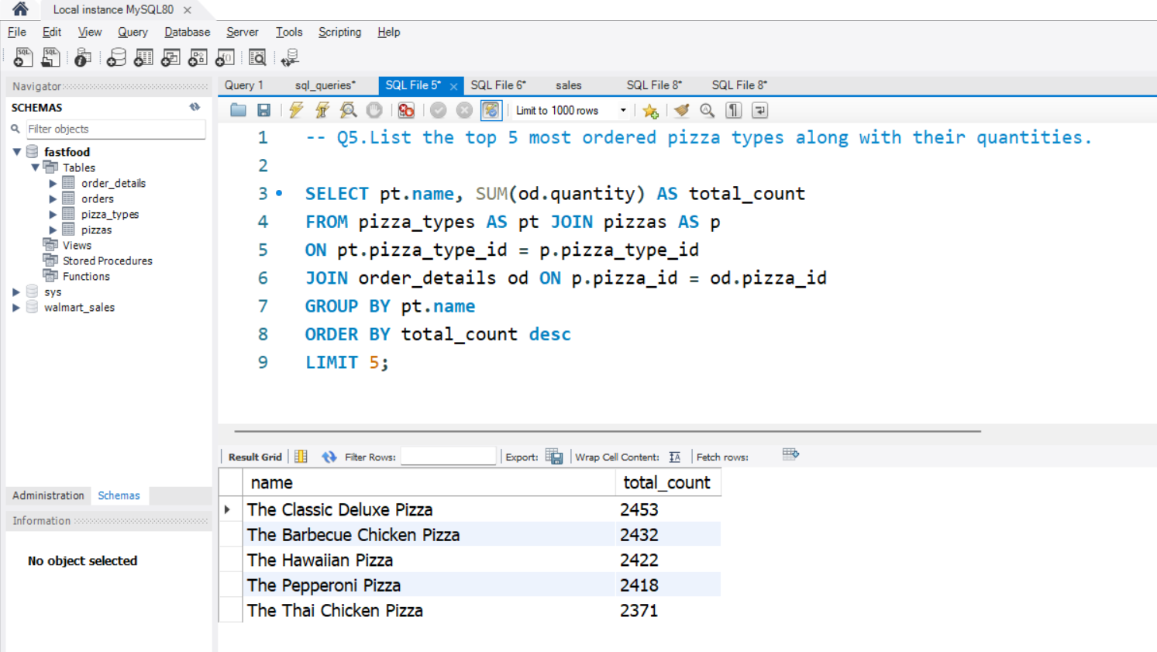
SQL QUERY TO FIND COMMONLY ORDERED PIZZAS
LEVEL - BASIC

Slide 9
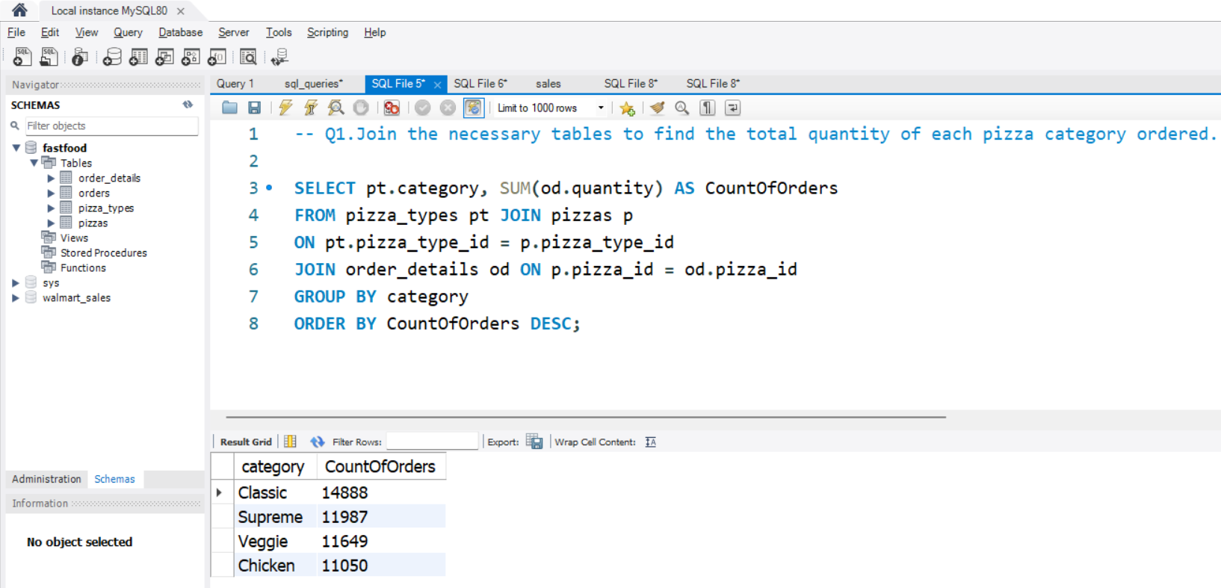
SQL QUERY TO FIND FREQUENTLY ORDERED PIZZA CATEGORY
LEVEL - MODERATE

Slide 10
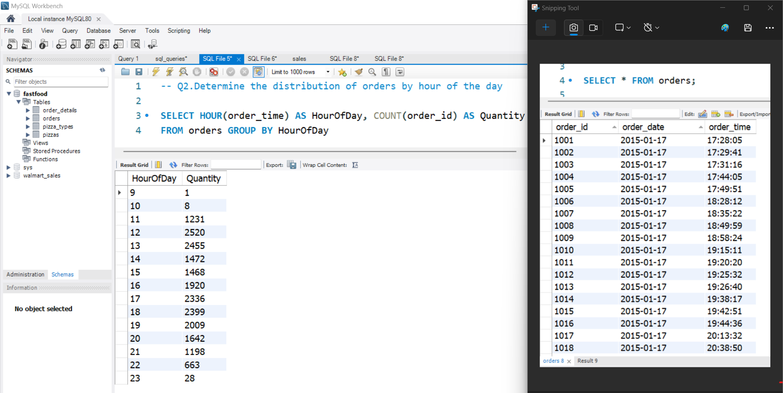
SQL QUERY TO FIND ORDERS PLACED BY HOUR OF DAY

Slide 11
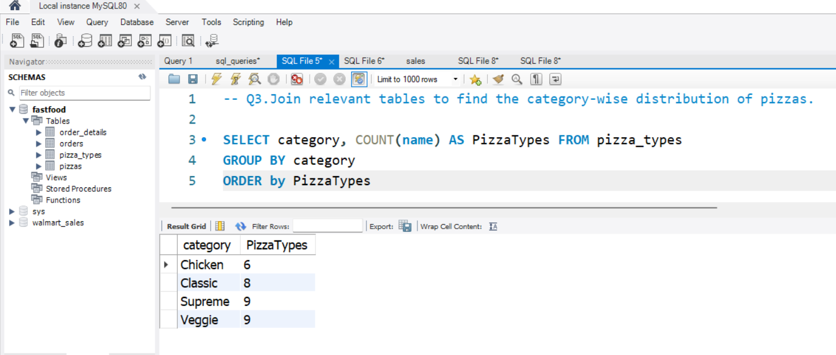
SQL QUERY TO FIND THE CATEGORY WISE DISTRIBUTION OF PIZZA
LEVEL - MODERATE

Slide 12
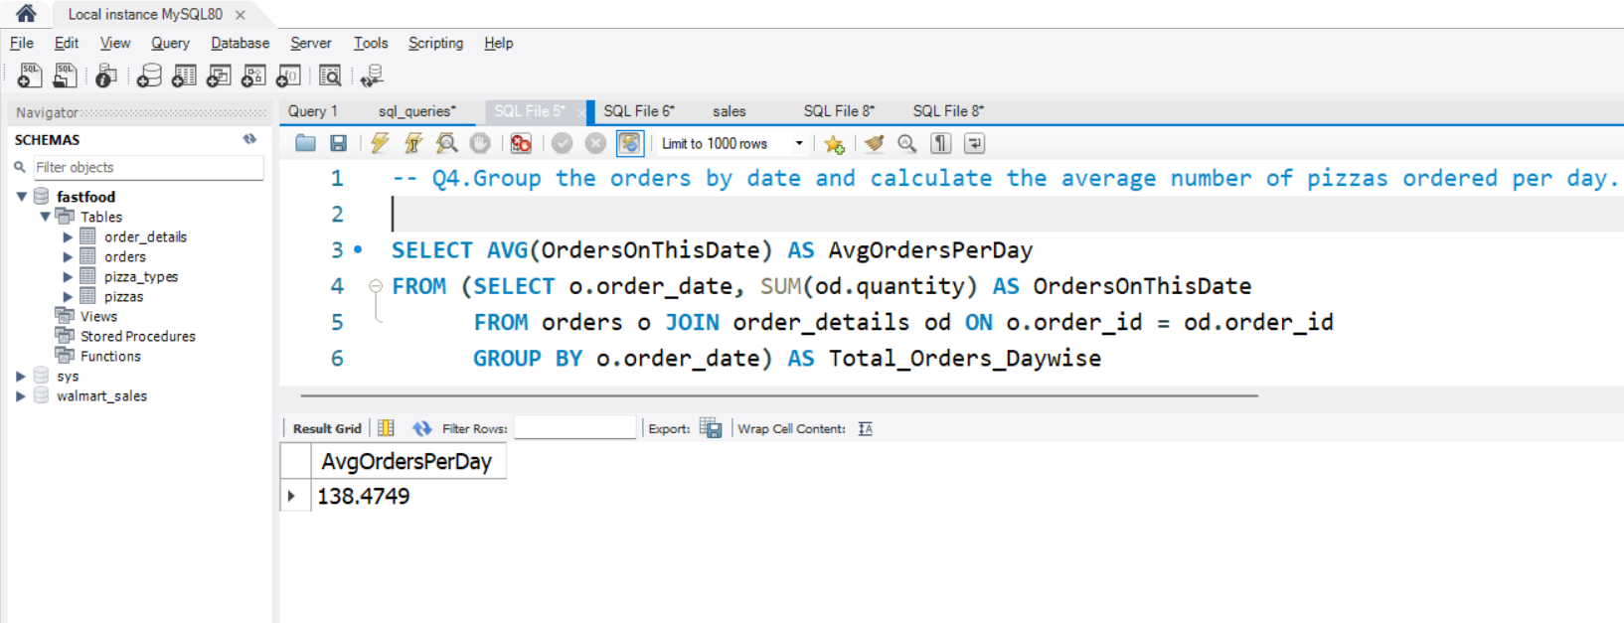
SQL QUERY TO FIND AVERAGE PIZZAS ORDERED PER DAY
LEVEL - MODERATE

Slide 13
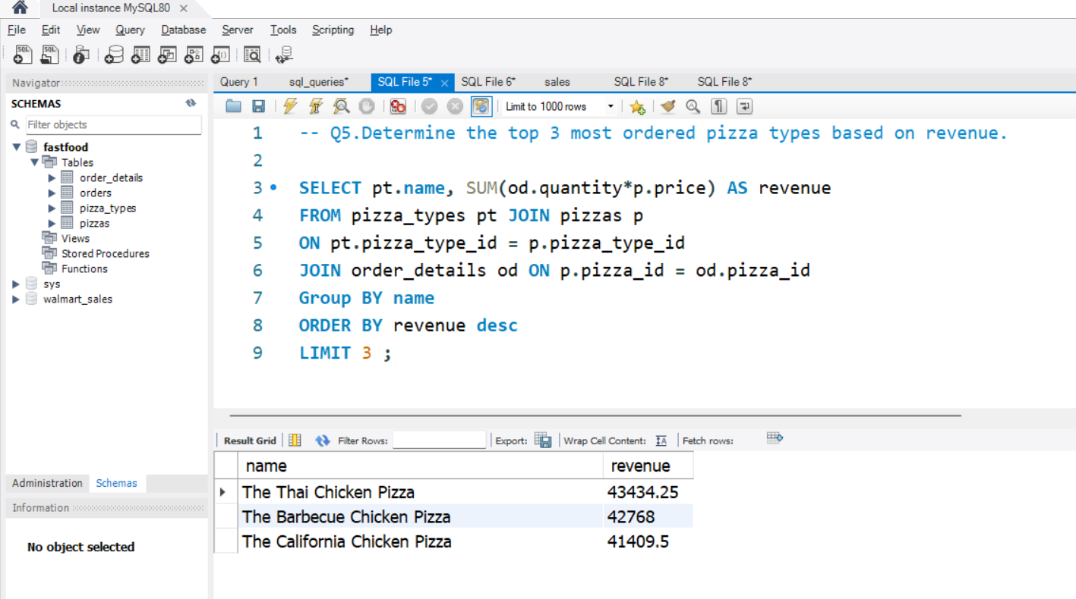
SQL QUERY TO FIND PIZZAS THAT GENERATED MOST REVENUE
LEVEL - MODERATE

Slide 14
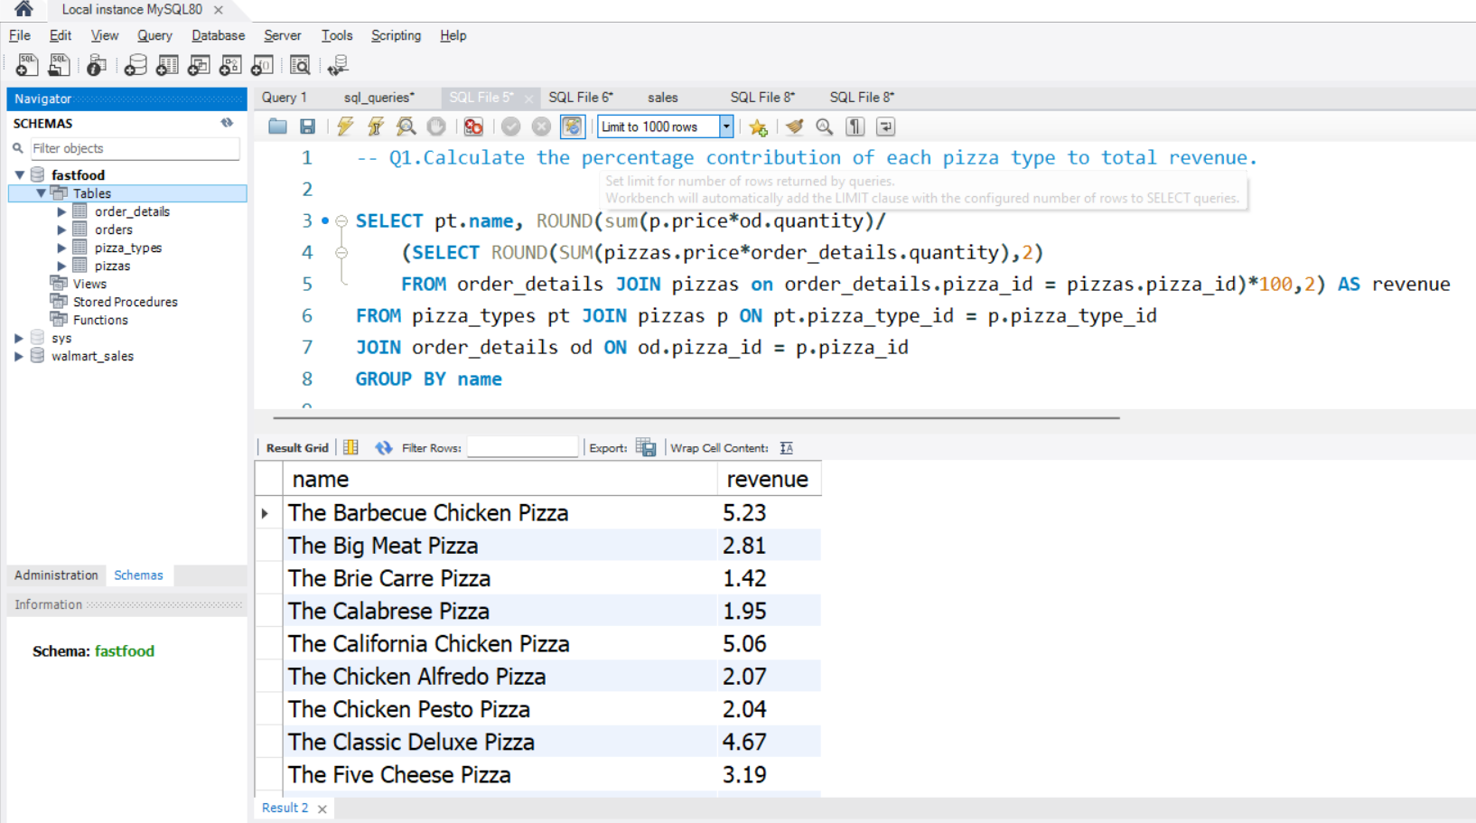
SQL QUERY TO FIND SALES PERCENTAGE PER PIZZA
LEVEL - ADVANCE

Slide 15

Final tips & takeaways
Consistent rehearsal
Strengthen your familiarity
Refine delivery style
Pacing, tone, and emphasis
Timing and transitions
Aim for seamless, professional delivery
Practice audience
Enlist colleagues to listen & provide feedback
15

Slide 16
THANK YOU
Vaishnavi Gajinkar
+91 9833690445
vaishnavi.gajinkar@gmail.com

